Slide 1


INNOVATION
TECHNOLOGY VALUE
RETAIL DX Profile - Software Development For Retail

Slide 2
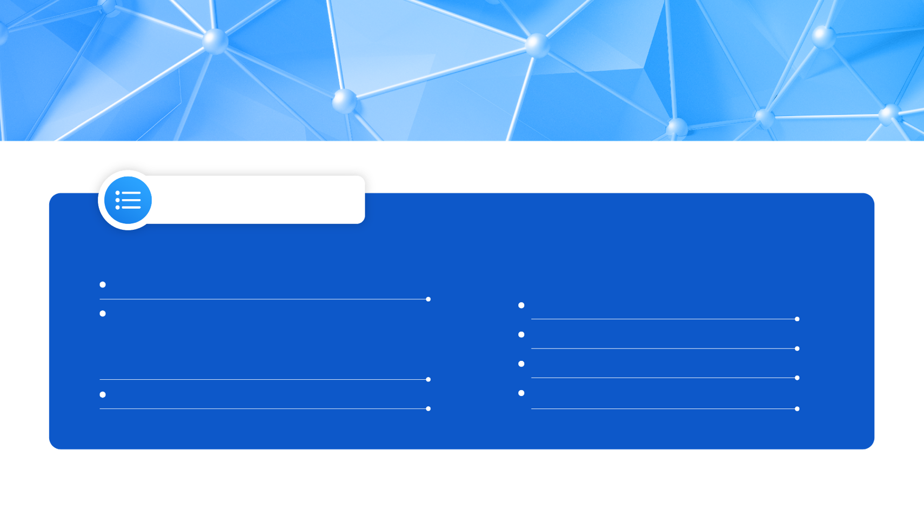



TABLE OF CONTENTS
ABOUT VTI
02
RETAIL DX SERVICES & SOLUTIONS
12
One-stop IT Service for Retailers
Our ecosystem
04
14
Software for Seamless CX
International Standard
07
18
19
Partner
Software for Smart In-store Operations
08
Software for Agile Business Operations
Our Services & Products
20
09
10
Why Us
11
CASE STUDIES
21
Technical Competencies
01
Copyright © 2025 VTI All rights reserved

Slide 3
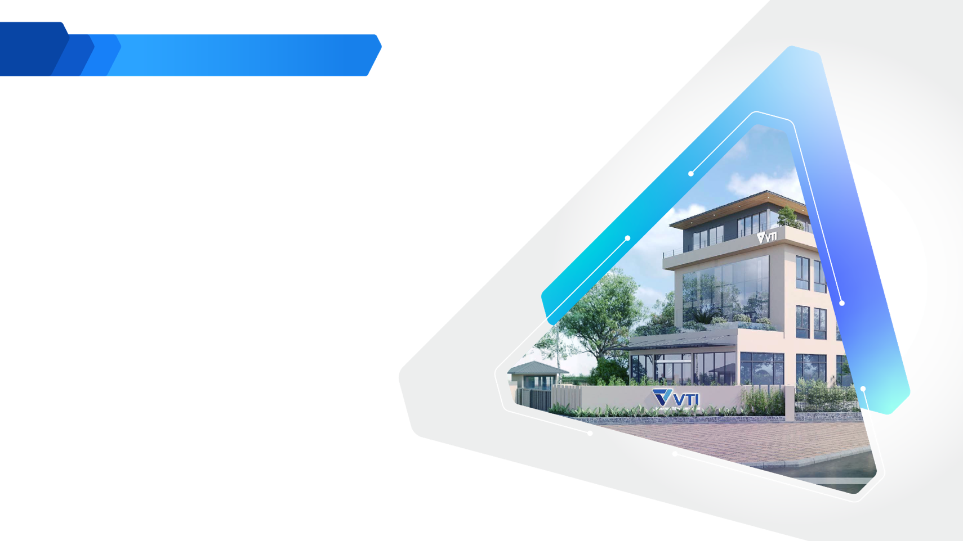

ABOUT VTI
Corporate Profile - For Software Development
Discover all the essential components that shape VTI's operations and distinguish the company in the global IT industry

Slide 4
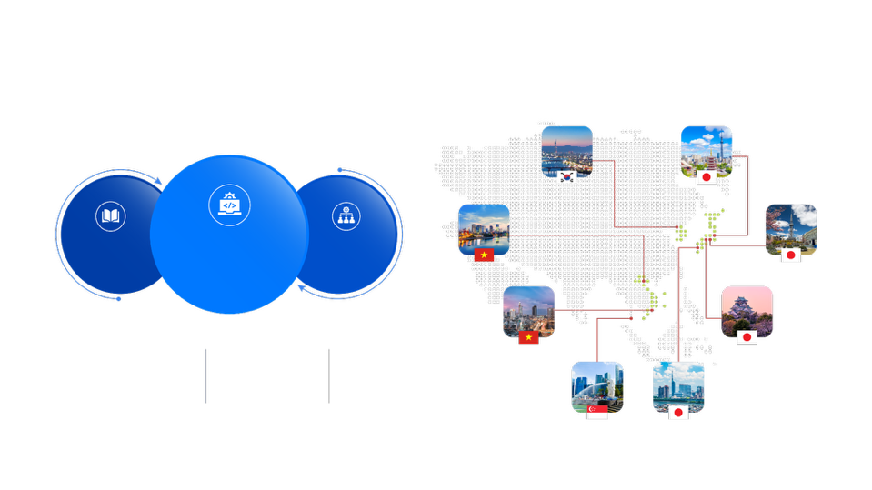

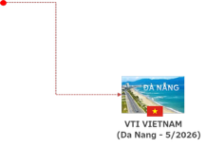
ABOUT VTI GROUP
Established in 2017, VTI Group stands as the Top 10 leading technology and IT service provider based in Vietnam, Japan, South Korea, and Singapore.
Our mission revolves around assisting businesses of all scales and across diverse industries to consult and operate in digital transformation.
At VTI Group, we gauge our success by the achievements of our customers, making their successes the ultimate measure of our value.
VTI KOREA
(Seoul)
VTI JAPAN
(Tokyo)
Education
& Training
IT Services
& Solutions
Human
Resources
VTI VIETNAM
(Ha Noi)
VTI JAPAN
(Nagoya)
1800+
9
4
VTI VIETNAM
(HCMC)
VTI JAPAN
(Osaka)
EMPLOYEES
OFFICES
COUNTRIES
VTI APAC (Singapore)
VTI JAPAN
(Fukuoka)
VTI VIETNAM
(Da Nang)
04
Corporate Profile - For Software Development

Slide 5







OUR ECOSYSTEM
IT OUTSOURCING & SOLUTIONS
Accumulate know-how
Providing comprehensive software & technology
solution for all manufacturing & retail industries,
leveraging AI & loT
Solution Consulting
Providing IT outsourcing services for target markets
EDUCATION & TRAINING
HUMAN RESOURCES
05
Corporate Profile - For Software Development

Slide 6


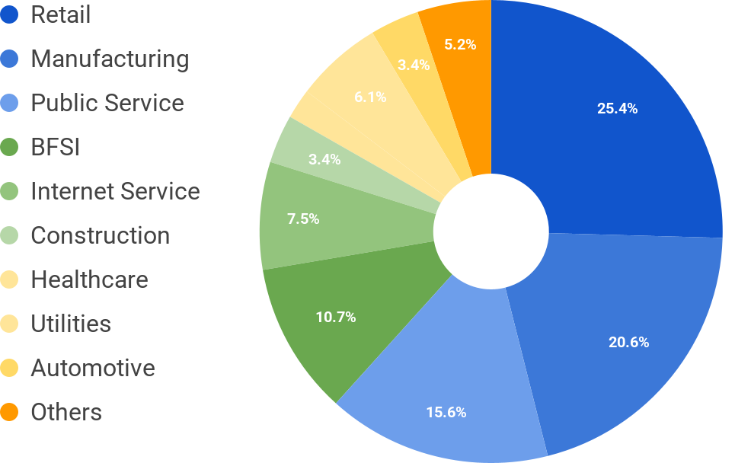
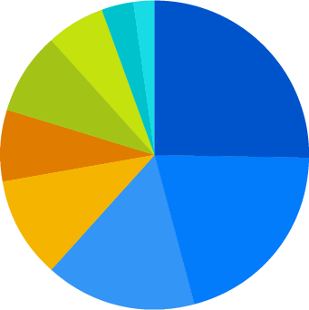
DOMAIN
CUSTOMERS
Retail
Others
15%
Manufacturing
Manufacturing
24%
3,39%
Public Service
6,09%
2,09%
Public sector
15%
Banking & Finance
8,57%
25,44%
Internet Service
7,52%
Cloud service
8%
Retail
20%
Construction
Healthcare
10,65%
20,62%
Finance
18%
Utilities
15,63%
VTI is dedicated to delivering insightful software development services to a wide-ranging client base in diverse industries, out of which Manufacturing and Retail are our two focused sectors.
Automotive and Others
350+
1200+
06
CUSTOMERS
PROJECTS
Corporate Profile - For Software Development
Notes:
$

Slide 7











OUR AWARDS & RECOGNITION
INTERNATIONAL STANDARD FOR SOFTWARE DEVELOPMENT
ASEAN DIGITAL AWARDS (ADA) 2025 - Silver Award
CMMI Maturity Level 3
Scrum Master
TOP 10 ICT 2025
MAKE IN VIETNAM 2025 - Gold Award
by Ministry of Science and Technology
PMI PMP
ITIL® 4 Foundation
BEST PLACES TO WORK 2025
SAO KHUE 2024
PrivacyMark System
ISO/IEC 27001
07
Corporate Profile - For Software Development

Slide 8




PARTNER
Odoo
ERP Partner
AWS Partner
Microsoft Partner
For Data Analytics
IBM Service Partner
International Standard
Adobe Ecommerce
(Magento) Partner
ServiceNow Consulting
and Implementation Partner
Salesforce
Partner
08
Corporate Profile - For Software Development

Slide 9

OUR SERVICES & PRODUCTS
Corporate Profile - For Software Development
VTI provides high-quality, one-stop services and products that caters to various customer needs, leveraging our abundant and skilled workforce

Slide 10
SOFTWARE DEVELOPMENT SERVICES
Software Development
Migration
Maintenance & Monitoring
Managed Service
• Website development service
• Mobile application service
• UI/UX design
• Mud migration
• Data migration
• Application & system maintenance
• IT environment optimization & support
• Cross-platform & cloud application
maintenance
• Cloud and infrastructure
• Application managed services (AMS)
• ITSM & enterprise application
• Industry-specific managed services
• Data & analytics
Fundamental Services
AI
Cloud Computing
IoT-Embedded
Cutting-edge technologies
• Computer vision (OCR, eKYC, vision inspection, smart insight)
• Data Analytics
• Natural Language Processing (NLP)
• Generative AI
•Managed service
• Migration & modernization service
• Development service
• Well-architectured review
•Cloud-based IoT application
• M2M network development
• Device development
ERP & CRM
Business Automation
Cyber Security
Ecommerce
•SAP
• Odoo
• Salesforce
•Low-code development
OutSystems
Microsoft Power Platform
ServiceNow
• Robotic Process Automation (RPA)
•Pentesting
• Threat & vulnerability management
• Security implementation service
• Self-build ecommerce development
• Platform-based ecommerce
development
Others
10
Corporate Profile - For Software Development

Slide 11















COMPUTER VISION
AI CONSERVATIONAL &
NATURAL LANGUAGE PROCESSING (NLP)
DATA ANALYTICS
GENERATIVE AI
Framework/ Libraries
Certificates
AI SERVICE
OCR (Optical character recognition)
eKYC (Electronic know your customer)
Vision inspection
Smart insight
Anomaly detection & analytics
Predictive maintenance
Demand forecasting
Recommendation
Coding Generation
Text to speech
Chatbots
Voice processing
Speech to text
Automated Code Completion
Bug Detection and Fixing
Test Case Generation
Test Case, Test Script Generation
GenAI Chatbot
Models
Certificates
Framework/ Libraries
Resources
Pytorch, Caffe, TensorFlow, Keras
OpenCV, Scikit-Learn, Pandas, Matplotlib
Programming languages: Python, R
20+
AI Engineers, leading by an Expert with PhD in Artificial Intelligence and Machine Learning
25+
AI development projects
11
11
11
20+
Corporate Profile - For Software Development
Corporate Profile - For Software Development
Scientific research projects and 20 international articles
Pytorch, Caffe, TensorFlow, Keras
OpenCV, Scikit-Learn, Pandas, Matplotlib
Programming languages: Python, R

Slide 12
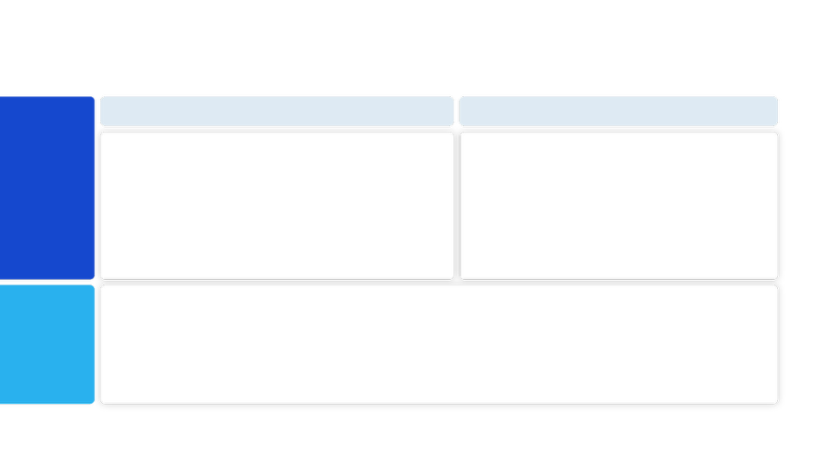





MADE-BY-VTI PRODUCTS & SOLUTIONS
VTI Solutions has expertise in providing customised highly-scalable software & solutions for customers in diverse industries,
especially Manufacturing and Retail
MANUFACTURING EXECUTIVE SYSTEM
SMART ACCESS CONTROL
Smart facial recognition attendance
management system
Manufacturing Execution
System
Maintenance
Management System
DX for
smart factory
Bus Operation & Fleeting
management system
Warehouse
Management System
Traceability
Management System
AI-based smart license plate recognition system
Quality Management
System
Procurement
Management System
LCD Virtual Receptionist
Smart facial recognition
attendance management system
AI-based smart license plate recognition system
DX for
smart office
Smart Meeting
Management
Bus Operation & Fleeting
management system
LCD Virtual Receptionist
12
Corporate Profile - For Software Development

Slide 13


Retail DX Service Profile
RETAIL DX SERVICES & SOLUTIONS
13
RETAIL DX Profile - Software Development For Retail

Slide 14

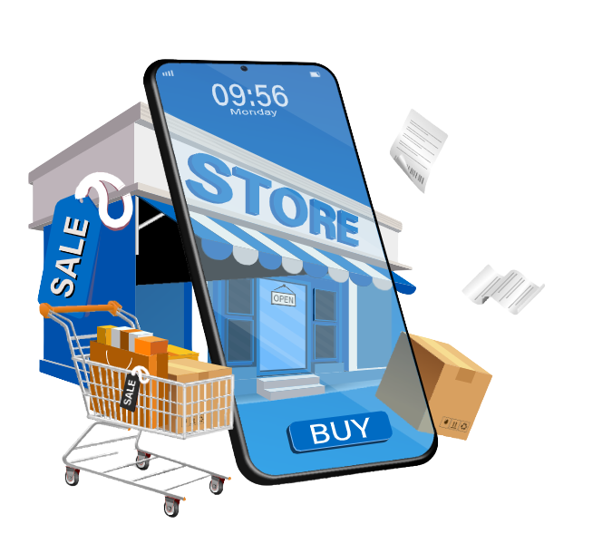




RETAIL DX SERVICES & SOLUTIONS OVERVIEW
Success in today’s fast-paced retail industry requires agility, innovation, and seamless operations.
As a trusted DX partner of multiple retailers, VTI offers advanced one-stop retail services and solutions to optimize operations, cut costs, and enhance excellent customer experience (CX). We are here to help retailers stay competitive in this ever-changing market.
Leveraging the core technologies
MOBILE APPLICATION DEVELOPMENT
AI & ML
CLOUD COMPUTING
14
RETAIL DX Profile - Software Development For Retail

Slide 15








ONE-STOP IT SERVICE FOR RETAILERS
RETAIL CONSULTING
SOFTWARE DEVELOPMENT
OPERATION & MAINTENANCE
Offer expert consulting and support for advanced technology implementation in the retail sector, helping businesses drive sales and maximize revenue growth.
Integrate advanced technologies such as AI/ML, IoT, and Cloud Computing into customer infrastructure to build comprehensive platforms, applications, and business systems.
Provide operation and maintenance services to ensure stable system performance, streamline daily operations, and minimize downtime.
WE OFFER RETAILERS
Software for Seamless CX
(Customer Experience)
Software for Smart In-store Operations
Software for Agile Business Operations
15
RETAIL DX Profile - Software Development For Retail

Slide 16
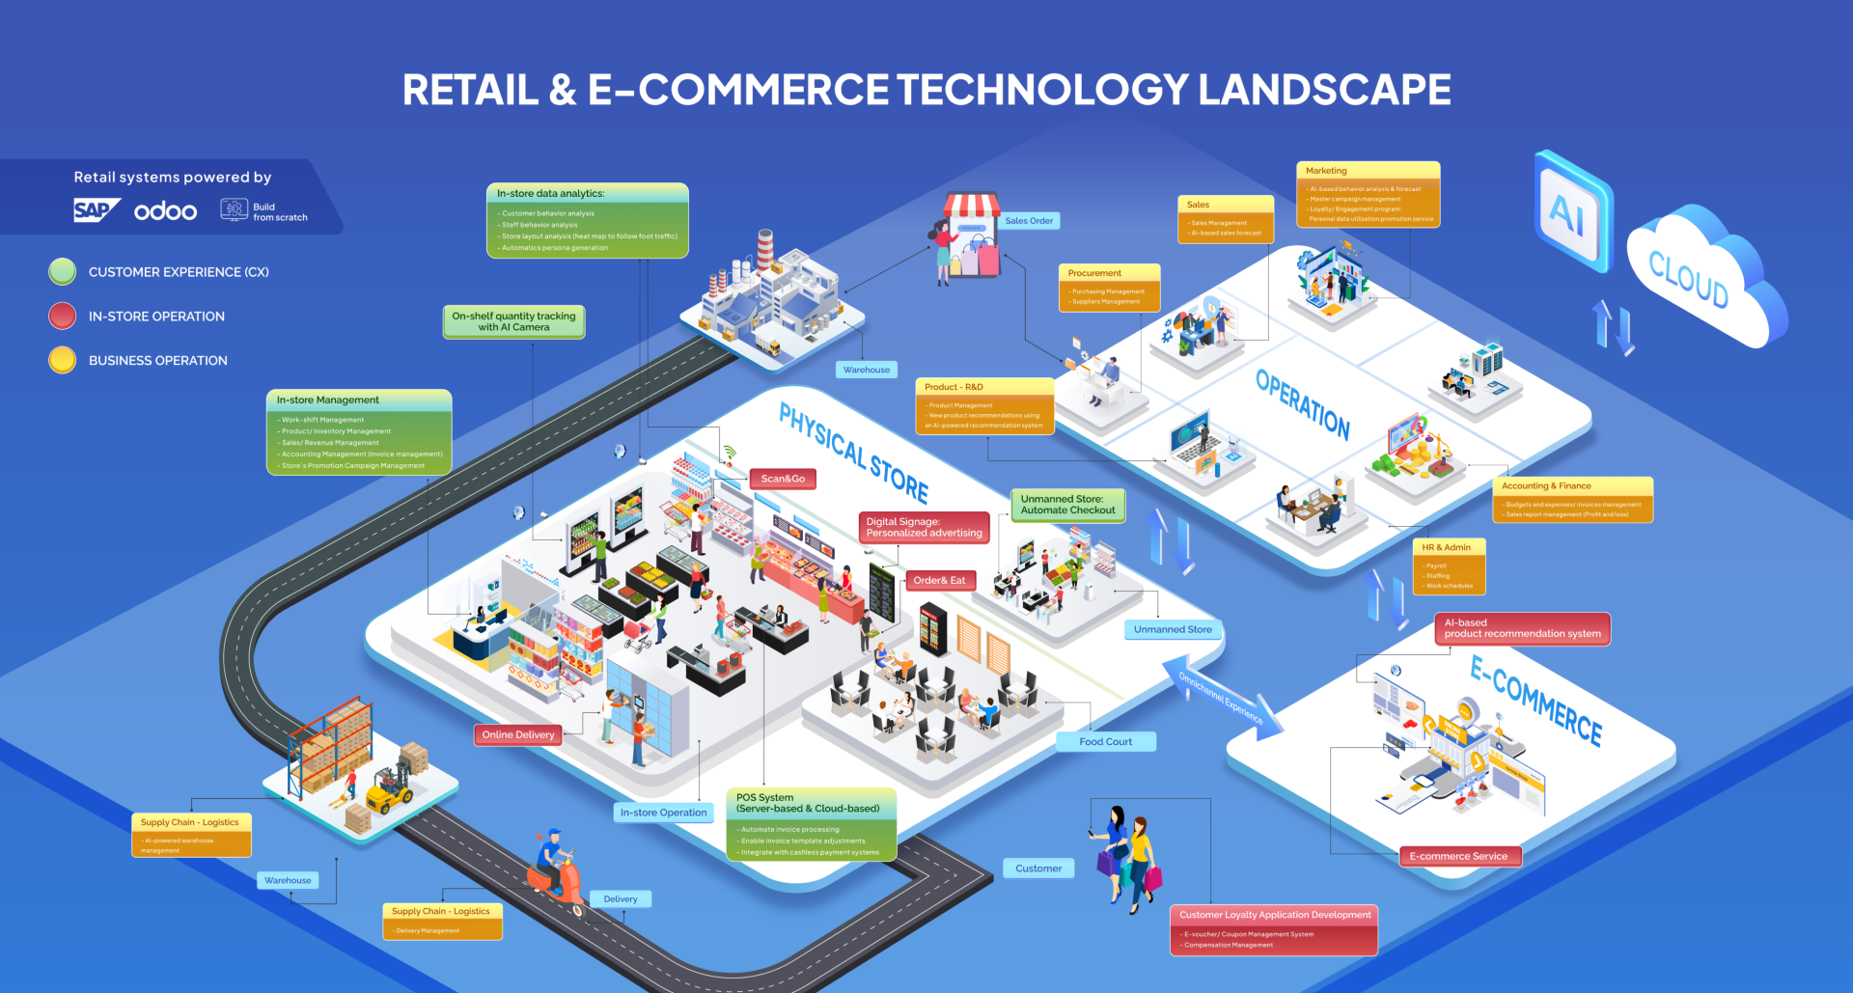

Slide 17

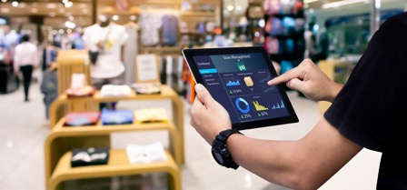







ONE-STOP IT SERVICE FOR RETAILERS
SEAMLESS CUSTOMER EXPERIENCE (CX)
SMART IN-STORE OPERATIONS
AGILE BUSINESS OPERATIONS
Deliver a seamless, personalized shopping experience with AI-driven insights and omnichannel integration.
Optimize in-store efficiency with AI-powered management, automation, and analytics.
Leverage from AI and automation to top advanced technology, VTI offer tailored systems that streamline retail business operations.
Tailored systems are designed to meet businesses' needs
based system
based system
built completely from scratch
16
RETAIL DX Profile - Software Development For Retail

Slide 18
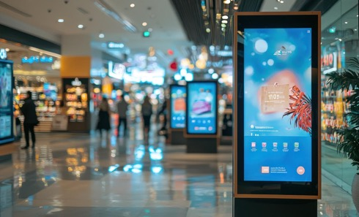
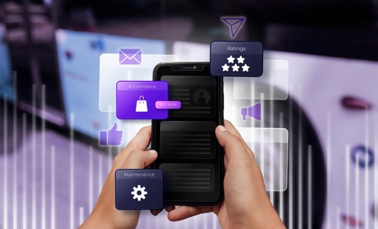




SOFTWARE SOLUTION FOR SEAMLESS CUSTOMER EXPERIENCE
DIGITAL SIGNAGE
CUSTOMER LOYALTY APPLICATION DEVELOPMENT
OMO - SEAMLESS OMNI-CHANNEL PURCHASING EXPERIENCE
Personalized advertising to engage customers in-store, leveraging AI technology
Develop loyalty applications/systems with
▶ E-voucher/ Point/ Coupon Management System
▶ Compensation Management for better customer engagement & loyalty.
Enable seamless shopping experiences across online and offline channels, streamlining transactions and ordering for convenience with
▶ E-commerce Service
▶ AI-based product recommendation system
▶ Scan&Go
▶ Order&Eat
▶ Online Delivery
17
RETAIL DX Profile - Software Development For Retail

Slide 19

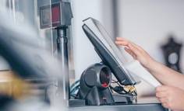



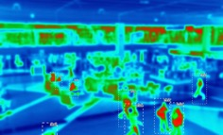


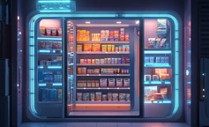

SOFTWARE FOR SMART IN-STORE OPERATIONS
IN-STORE MANAGEMENT
POS SYSTEM
Oversee store operation from staffing, inventory, sales, to promotions with IT technology.
▶ Work-shift Management
▶ Product/ Inventory Management
▶ Sales/ Revenue Management
▶ Accounting Management (invoice management)
▶ Store’s Promotion Campaign Management
(Server-based & Cloud-based)
▶ Automate invoice processing
▶ Enable invoice template adjustments
▶ Integrate with cashless payment systems
ON-SHELF QUANTITY TRACKING
Monitor stock levels in real-time to prevent shortages using AI Camera
IN-STORE DATA ANALYTICS
Analyze customer/staff behaviors, foot traffic, and store layout using heatmap insights.
▶ Customer behavior analysis
▶ Staff behavior analysis
▶ Heatmap for store layout analysis
▶ Automatics persona generation
UNMANNED STORE
Enable cashier-less checkouts with AI-driven automation (face recognition system, AI payment system, etc.)
18
RETAIL DX Profile - Software Development For Retail

Slide 20














SOFTWARE FOR AGILE BUSINESS OPERATIONS
SALES
PROCUREMENT
▶ Sales Management
▶ AI-based Sales Forecast
▶ Purchasing Management
▶ Suppliers Management
PRODUCT - R&D
SUPPLY CHAIN - LOGISTICS
▶ Product Management
▶ New product recommendations using an AI-powered system
▶ Warehouse Management System (WMS)
▶ Delivery Management System
▶ Receipt/ Shipping Management
MARKETING
ACCOUNTING & FINANCE
▶ AI-based behavior analysis & forecast
▶ Master campaign management
▶ Loyalty/ Engagement program: Personal data utilization promotion service
▶ Budgets & expenses/ invoices management
▶ Revenue report management (Profit and loss)
HR & ADMIN
▶ Payroll & Staffing
19
RETAIL DX Profile - Software Development For Retail

Slide 21


CASE STUDY
20
RETAIL DX Profile - Software Development For Retail

Slide 22












CASE STUDY | PROCUREMENT MANAGEMENT SYSTEM IN RETAIL - FOR SMARTER INVENTORY CONTROL (1/4)
01
Overview
A Japanese leading convenience store chains
This case study showcases the successful implementation of a cloud-based Procurement Management System for a leading Japanese retail chain. VTI developed the solution to automate goods procurement workflows, enhance inventory accuracy, and improve scalability. By leveraging cloud technology and automation, the new system optimizes goods importing, reduces operational costs, and streamlines supplier management, ensuring seamless and efficient retail operations.
Procurement Management System
Headquartered
in Japan
Over
45 years in the retail industry
Customer Challenges & Requirements
The existing system could no longer support the company's procurement needs. Employees managed goods import data using separate Excel files and emails, leading to several operational challenges
2000+ stores in Japan
Thousands of stores worldwide
High risk of stock/goods discrepancies
Due to inventory and goods import data being calculated and uploaded manually to the system from multiple files.
Inefficient workflows and inability to utilize historical data
As the inventory management/ importing data is uncentralized, it was hard to reuse historical data/documents for different reports when needed, resulting in time and resources consuming
21
Fragmented data and high operational costs
Due to lack of system integration.
Limited scalability
makes it difficult to add new features, and utilize new technology to adapt to business growth.

Slide 23








CASE STUDY | PROCUREMENT MANAGEMENT SYSTEM IN RETAIL - FOR SMARTER INVENTORY CONTROL (2/4)
01
VTI’s Approach
A Japanese leading convenience store chains
VTI delivered
One-Stop - Full-cycle Development service:
Maintenance
Requirement definition & Planning
Headquartered
in Japan
5
1
Over
45 years in the retail industry
Basic & Detailed Design
Testing
Unit Testing (UT)
Integration Testing (IT)
System Testing (ST)
4
2
2000+ stores in Japan
Thousands of stores worldwide
3
System Development
Technology Used
Infrastructure: AWS Services
Cloud-based infrastructure (AWS) for lower costs and better scalability.
Serverless framework to ensure high performance with minimal infrastructure costs
Project Scales
Team Size: Up to 30 personnel
Working Model: Hybrid (Onsite + Offshore)
Duration: 6+ months
22

Slide 24





Procurement Management System
CASE STUDY | PROCUREMENT MANAGEMENT SYSTEM IN RETAIL - FOR SMARTER INVENTORY CONTROL (3/4)
Procurement Management System
Orders
Key Features
Center Orders
Supplier (Maker) Management
via Fax, Phone, Internet
Orders Management
Logistics Management
Sales Management
Order Request Management
Price Quote Management
Statistical management
Inventory Management
Production Management
Order Management
Incoming Goods Management
Payment Management
Purchase Management
External Linkage
send purchasing order
Inventory tracking (numbers of goods imported from suppliers) and stock control (in-stock and goods sell-out data)
Forecasting and stock replenishment recommendations for new periods of goods imports.
Client
Suppliers
Additional Features
Invoice
Demand Forecasting
Out-of-stock Notification
General Data Output
Invoice
Real-time stock vs supplier invoice comparison
Data Aggregation Dashboard
Differences Comparison List
General Data Input
Payment
Payment
23
Products/ Goods Delivery

Slide 25
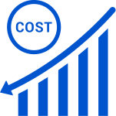

CASE STUDY | PROCUREMENT MANAGEMENT SYSTEM IN RETAIL - FOR SMARTER INVENTORY CONTROL (4/4)
01
Result
A Japanese leading convenience store chains
6 times (600%)
on Initial & Operational Expense
50%
on Work Hours in procurement-related tasks
Headquartered
in Japan
Cost reduction:
Migrating to a Cloud-based system cut initial and operational expenses by 6 times.
Increase Efficiency:
Automated workflows reduced procurement-related (inventory management, goods importing, stock replenishment forecast) work hours by 50%.
Data accuracy:
Fewer manual errors improved inventory tracking and order accuracy.
Increase effective order forecast:
The system leverages past data to give suggestions on order forecasts for the next procurement period.
Procurement Management System
Over
45 years in the retail industry
2000+ stores in Japan
Thousands of stores worldwide
24

Slide 26

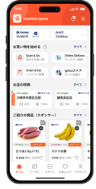
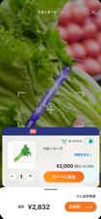

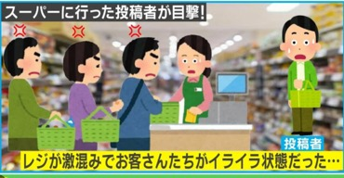
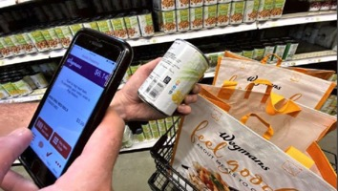





CASE STUDY | SCAN&GO - RETAIL SMART MOBILE APPLICATION:
FROM LONG QUEUES TO SEAMLESS SUPERMARKET SHOPPING (1/7)
02
Overview
Japanese leading supermarket /retail chains
VTI developed a mobile solution Scan&Go - A Retail Super App integrating self-checkout, online delivery, and loyalty programs, enhancing customer experience, operational efficiency, and engagement for a leading Japanese retail company across 500+ stores
point
500+
Stores apply
Headquartered
in Tokyo, Japan
point
point
900K+
Downloads
Founded in
2014
Customer Challenges & Requirements
With growing customer demand and smartphone adoption, the company identified their need to modernize shopping and checkout experience
Operating
4 famous supermarket brands
over 650 stores across Japan
Technologies used
Cross-platform development: React Native
Backend architecture: C#
Long checkout lines
to improve customer satisfaction and prevent missed sales
Digital promotions &
loyalty programs
to enhance customer engagement
Operational efficiency
to reduce cashier workforce costs
Store foot traffic & revenue
through seamless shopping experiences
25

Slide 27




CASE STUDY | SCAN&GO - RETAIL SMART MOBILE APPLICATION:
FROM LONG QUEUES TO SEAMLESS SUPERMARKET SHOPPING (2/7)
02
VTI’s Approach
Japanese leading supermarket /retail chains
VTI delivered
One-Stop - Full-cycle Development service:
Maintenance
Requirement definition & Planning
Headquartered
in Tokyo, Japan
5
1
UI/UX Design
Founded in
2014
Testing
Unit Testing (UT)
Integration Testing (IT)
System Testing (ST)
4
2
Operating
4 famous supermarket brands
over 650 stores across Japan
3
Application Development
Technologies used
Cross-platform development: React Native
Backend architecture: C#
Technology Used
Cross-platform development: React Native for a seamless mobile experience.
Backend architecture: Microservices using C# for scalability and flexibility.
UI/UX design: A high-performance, user-friendly interface ensuring intuitive navigation and a smooth shopping experience.
The “Supper App” comprised 3 main applications
1- Scan&Go
2- Online Delivery
3- Order & Eat
26

Slide 28










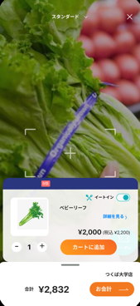
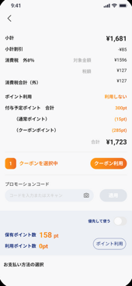
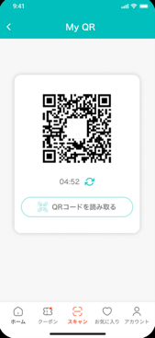


CASE STUDY | SCAN&GO - RETAIL SMART MOBILE APPLICATION:
FROM LONG QUEUES TO SEAMLESS SUPERMARKET SHOPPING (3/7)
1- SCAN & GO
Scan & Go: Mobile self-checkout, eliminating long cashier queues
How Scan&Go Feature Works
Download App
Check-in at the store
Scan Products
Process Payment
Check-out
point
point
point
Download App on AppStore/ PlayStore
Check-in at the store you want to buy
Scan product’s barcode to check information & put into cart with the Mobile App
When finish shopping, choose Check-out → Purchase and process payment
Hold the displayed QR code at the store’s scanner to complete transaction
27

Slide 29

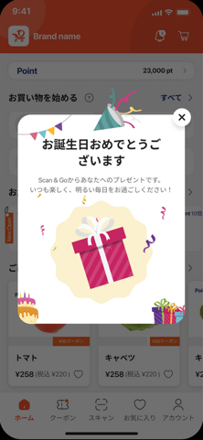




CASE STUDY | SCAN&GO - RETAIL SMART MOBILE APPLICATION:
FROM LONG QUEUES TO SEAMLESS SUPERMARKET SHOPPING (4/7)
1- SCAN & GO
Scan & Go: Mobile self-checkout, eliminating long cashier queues
Other Highlight Features
Gate App
Pop-up Survey feature
Customers complete checkout by scanning their card at a terminal, enabling purchase verification and security checks (the store has the uploaded product purchase details, including the age restriction with alcoholic beverages)
Displays NPS (Net Promoter Score) surveys post-purchase, customizable for stores, products, and registers. This would help stores to evaluate and get more insights.
アプリ
Nutritional value visible display
Coupons and Promotional Measures
The app can track purchase data, visualize the nutritional balance of the chosen products, and even suggest nutrient-rich ingredients/ dishes for users.
Issue personalized electronic coupons and display promotional banners that are synergistic with the store’s banner to enhance consistency and boost sales.
28

Slide 30








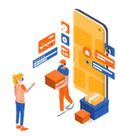





CASE STUDY | SCAN&GO - RETAIL SMART MOBILE APPLICATION:
FROM LONG QUEUES TO SEAMLESS SUPERMARKET SHOPPING (5/7)
2- ONLINE DELIVERY
Online Delivery: Convenient groceries shopping through the app or website, then user can choose to receive with home delivery & in-store pickup
How Online Delivery Feature Works
Customers
Customers
Online Order
Process Online Payment
Pick-up
Order Information
Order Information
Store’s Staff Prepare Order
Online Delivery Server
Home Delivery
Store’s Product Picking App
Or
Choose the products on the App
Fast Pick-up at Store
29

Slide 31



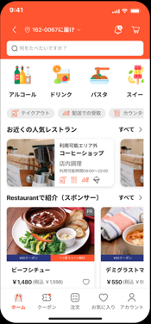
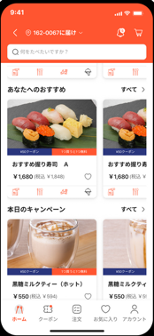



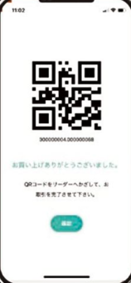



CASE STUDY | SCAN&GO - RETAIL SMART MOBILE APPLICATION:
FROM LONG QUEUES TO SEAMLESS SUPERMARKET SHOPPING (6/7)
3- ORDER & EAT
Order & Eat: Pre-order food and reserve tables at in-store restaurants.
How Order&Eat Feature Works
Select Store/Menu
Process Online Payment
Pick-up
Less wait time
Home Delivery
Convenient
Enjoy hot/
Freshly cooked food
Or
Fast Pick-up at Store/ Dine-in
Select the nearest store and place order/ reserve table in advance
Proceed online payment
(cards, credit, e-wallet, etc)
30

Slide 32
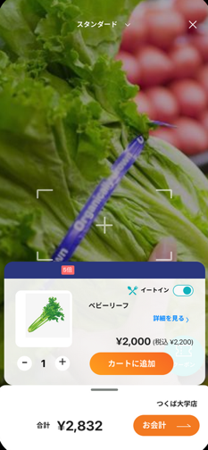


CASE STUDY | SCAN&GO - RETAIL SMART MOBILE APPLICATION:
FROM LONG QUEUES TO SEAMLESS SUPERMARKET SHOPPING (7/7)
02
Result
Japanese leading supermarket /retail chains
500+
Stores apply
High User Adoption:
The app reached over 900,000 downloads by the end of 2024. The application is used across 500+ supermarket stores in Japan
Headquartered
in Tokyo, Japan
900K+
Downloads
Strong User Retention:
Frequent updates and loyalty-based features contributed to a high return user rate. The app is highly rated for its concept & UX/UI
Founded in
2014
71%
Performance Boost
71% Performance Enhancement
Initial performance challenges were addressed, but with VTI’s Kaizen core value, the team quickly researched, identified the problems, and had improvement measures, leading to a 71% performance boost.
Operating
4 famous supermarket brands
over 650 stores across Japan
Technologies used
Cross-platform development: React Native
Backend architecture: C#
Increased Customer Engagement
The app integrated a robust loyalty program, offering monthly digital coupons, personalized events such as birthday rewards, and special promotions, enhancing customer retention and repeat purchases.
Integrated a robust loyalty program
31

Slide 33









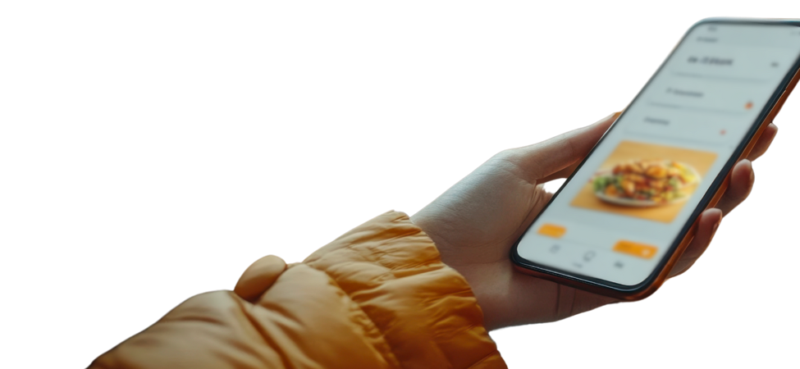


CASE STUDY | FROM CONCEPT TO REALITY: DEVELOPING MINISTOP APP - REVOLUTIONIZING DX IN CONVENIENT STORES (1/3)
03
Overview
VTI’s Solution
MINISTOP, a member of AEON Group, is a leading convenience store chain in Japan
This case study highlights VTI’s successful development of the MINISTOP mobile app, helping Japan’s leading convenience store chain enhance digital marketing, boost customer engagement, and launch mobile ordering. VTI delivered a full-cycle app development service, enabling MINISTOP to pioneer mobile ordering in Japan.
a one-stop full-cycle development service
VTI delivered covering from requirement analysis to deployment and maintenance.
Requirement definition
Conducted an in-depth evaluation and collaborated with the client to define feature requirements and create a detailed design.
MINISTOP APP’s Key Feature Demonstration
1.4M+
Registered users
Headquartered
in Chiba, Japan
100K+
Active users
UI/UX Design
Founded in
1980
Designed a high-performance, visually appealing, and intuitive user interface to provide a seamless shopping experience, ensuring ease of use and customer satisfaction.
Home Screen
Loyalty Program - WAON Point System Integration
Coupon Management
Available Coupon Listing Feature
Event Management
Display Event Listing & Tracking Feature
Rating
Customer Challenges & Requirements
Application Development (Coding)
2100+ stores in Japan
3250+ stores worldwide
Developed a robust, scalable, and responsive mobile application, that supports cross-platform functionality.
The client aimed to develop an official mobile app to enhance digital engagement and streamline customer interaction.
No specific feature requirements at the start.
Needed a one-stop service provider for planning, development & maintenance
Testing (Unit & Integration Testing)
Official brand communication channel
The application will act as an official brand’s communication channel & engagement channel with MINISTOP’s customers
Conducted testing to ensure a stable, bug-free application before deployment.
8 months
Launching the app within a short timeframe
Maintenance
st
Becoming the first convenience store chain in Japan to offer mobile ordering on a mobile app
Provided continuous support and updates, refining features and improving performance based on user feedback and business requirements.
32
1

Slide 34


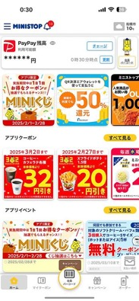
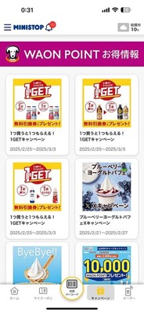
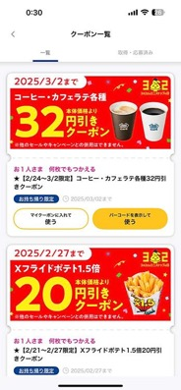
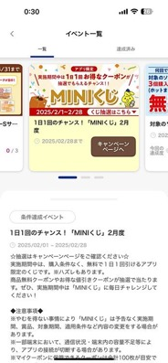


MINISTOP APP highlight features
CASE STUDY | FROM CONCEPT TO REALITY: DEVELOPING MINISTOP APP - REVOLUTIONIZING DX IN CONVENIENT STORES (2/3)
MINISTOP APP’s Key Feature Demonstration
Coupon Management
Distributing targeted coupons to specific user groups.
Event Management
Displaying events and tracking event progress.
Integration with WAON Point System
Enabling users to accumulate and redeem points.
Mobile Order & Payment
Supporting multiple payment methods, including PayPay, AuPay, DPay, credit cards, Rakuten Pay, and AEON Pay. Users could pre-order and pay through the app before picking up their items in-store.
Cross-Platform Support - Ensuring Seamless User Experience
Home Screen
Loyalty Program - WAON Point System Integration
Coupon Management
Available Coupon Listing Feature
Event Management
Display Event Listing & Tracking Feature
The app was developed to be fully compatible with both iOS and Android devices.
Scalability
The server infrastructure was designed to handle a large number of concurrent users efficiently.
33

Slide 35






CASE STUDY | FROM CONCEPT TO REALITY: DEVELOPING MINISTOP APP - REVOLUTIONIZING DX IN CONVENIENT STORES (3/3)
03
Result
Technology used
MINISTOP, a member of AEON Group, is a leading convenience store chain in Japan
Architecture: Microservices-based architecture.
Programming Languages:
Backend:
iOS:
Android:
Frameworks:
New Relic for cross-platform development.
Scrum Incremental model for agile development.
Infrastructure: AWS serverless architecture to support high scalability and performance.
MINISTOP APP’s Mobile Order UX/UI Demonstration
Headquartered
in Chiba, Japan
Founded in
1980
1.4M+
Registered users
27,000+
Reviews
50%
Store Foot Traffic
100K+
Active users
60%
Operational cost
Project Scale
2100+ stores in Japan
3250+ stores worldwide
Rating
Increase 50% Store Foot Traffic: Assisting in boosting sales
Faster development and Reduced 60% operational cost compared to traditional methods. Utilizing the billing structure of AWS based on the pay-as-you-go model, the application operation and maintenance can reduce infrastructure costs. (only pay for what you have used)
Development duration: 6-8 months, followed by continuous updates and operational enhancements.
Post-Launch Maintenance: Ongoing updates and feature improvements based on user feedback and business needs.
34

Slide 36
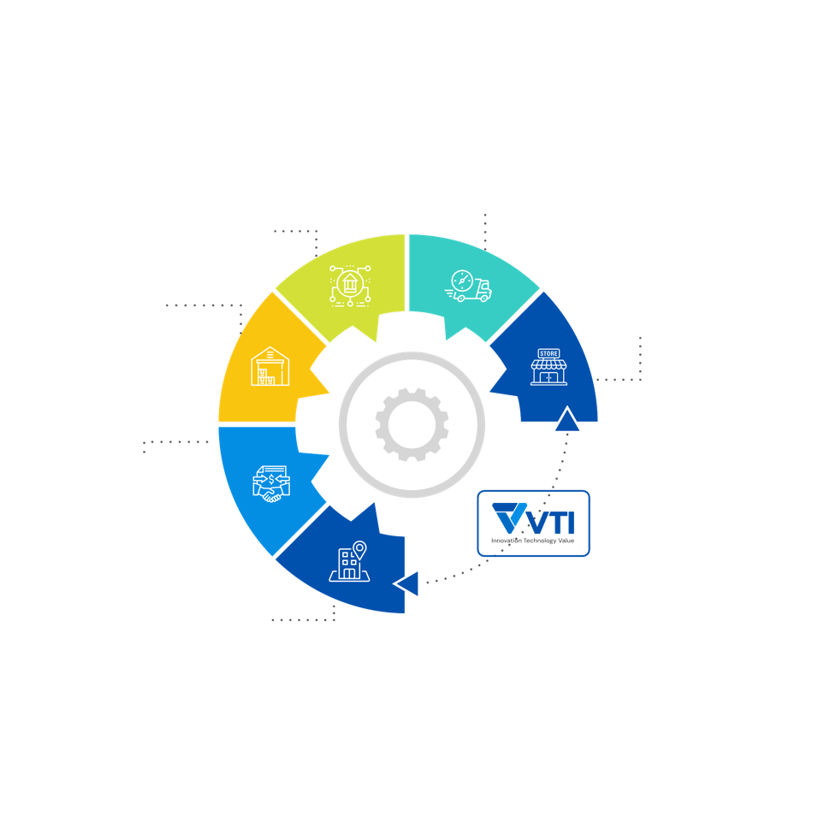
CASE STUDY | COMPREHENSIVE RETAIL SYSTEM DEVELOPMENT (1/4)
04
Approach
CHALLENGE
Learn by digging deep into retail systems and operations during development
Franchise Partner
Shipping
VTI has to acquire thorough know-how in retail industry generally and in customer business speciﬁcally in order to utilise up-to-date softwares & technologies
Involving in high-level processes with such a new business as micro-market
Warehouse
Store
Store Advisor
Store Manager
Franchise Partner
•
Procurement
Headquarter
^{Administration}
^{Finance}
^{Information technology}
^{Marketing}
Result
Comprehensive understanding of retail business acquired, therefrom building a centralized operation management system from headquarter to stores
Sufficient business knowledge accumulated for future micro-market projects
35

Slide 37



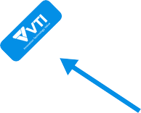




HIGH-LEVEL PROCESS DEVELOPMENT
CASE STUDY | COMPREHENSIVE RETAIL SYSTEM DEVELOPMENT (2/4)
Headquarters
Procurement
Warehouse
Store management
In-house procurement
management
Marketing
Product management
Business analysis
Franchise promotion
Production control
Finance
Order receiving
Delivery to warehouse
GOODS RECEIVED
Warehouse management
Periodic stock management
ORDER
FORWARDING
CONSIGNMENT
EARNINGS
Store
Delivery
Franchise partner
Sales
Product adjustment
Human Resources Management
Cash ﬂow management
Stock Receiving Management
Product Delivery
Delivery management
Business analysis
Store management
Financial management
SHIPPING
36

Slide 38














HEADQUARTERS SYSTEM
CASE STUDY | COMPREHENSIVE RETAIL SYSTEM DEVELOPMENT (3/4)
Planning
Management
Warehouse / Delivery
Finance
Operational management Business planning/
investment activities
Management plan implementation
Store management
Store data analysis
Franchise promotion
Receipt / shipment
management
Warehouse management
Delivery plan management
Carrier management
Cash ﬂow management
Business results
Product management
Marketing
IT
Product development
Product management
Supplier research
Demand analysis
Product promotion plan
Data analysis
Market research
Events
System operations management
System development support
Technical support
37

Slide 39








OPERATIONS MANAGEMENT
CASE STUDY | COMPREHENSIVE RETAIL SYSTEM DEVELOPMENT (3/4)
Store Advisor
Store Manager
Franchise Partner Manager
Store management
Status management
Business plan
Campaign implementation
Human resources management
Store management
Work schedule checking
Management status conﬁrmation
Sales management
Management status conﬁrmation
Store support
Employee
^{Accounting (POS)}
^{Import management}
^{Product inspection}
38

Slide 40
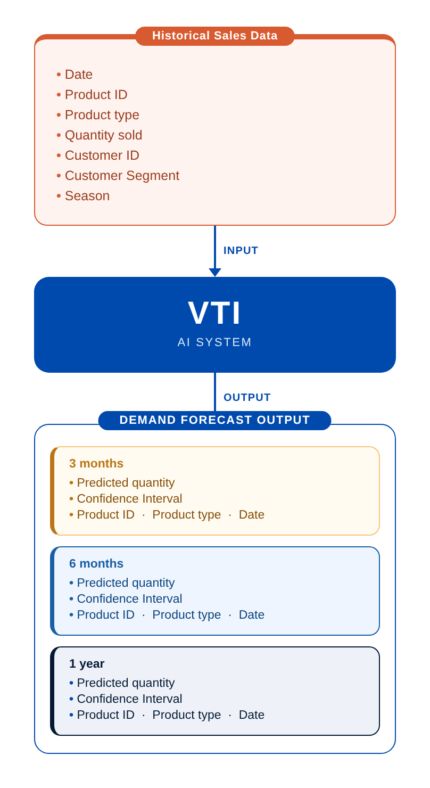
CASE STUDY | AI-BASED DEMAND FORECASTING SYSTEM
05
Client Overview
Customer established a local subsidiary in China in 2001. It has sales bases in Shanghai and Guangzhou, selling textiles in small quantities. They are used as footholds to expand trade not only in the Chinese market but also in the North American, European, and Asian markets and provide support to our customers’ global businesses.
Challenge
Customer is confronting a issue:
The demand forecasting system depends on human experience and analysis based on purchase data and related product information is of low accuracy.
Solution from VTI
Develop an automated demand volume forecasting solution based on AI/ML, which helps to:
Forecast the quantity of products for the next month, and the demand for each month, from T+1 to T+6
The forecast results are used weekly, with an update frequency of once per week
Results suggesting safe stock levels based on the forecasted quantity
39

Slide 41
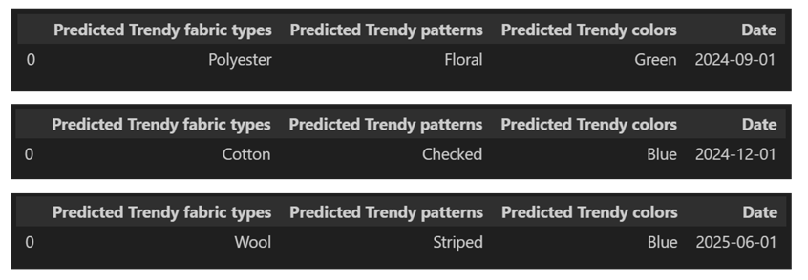
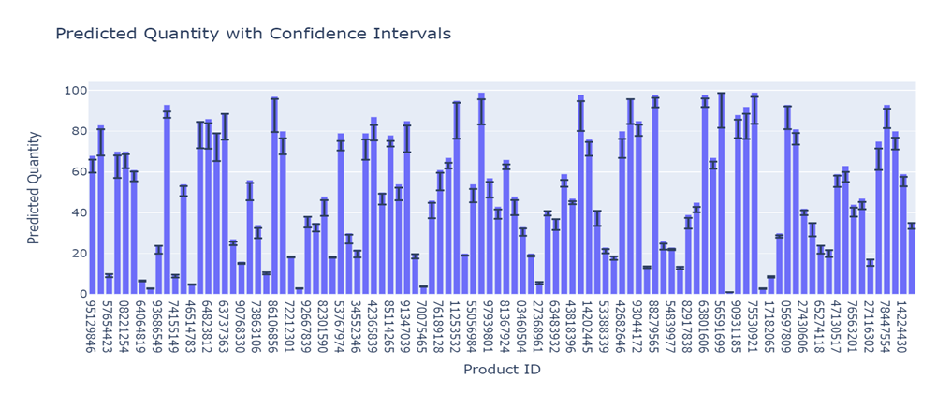
CASE STUDY | AI-BASED DEMAND FORECASTING SYSTEM
05
Result
Order volume & production volume optimised, sales revenue improved by 7%-10%
Market trends forecasting and support in advertising enabled to develop new products
Customer volume forecasting and pricing optimised -> inventory costs reduced, proﬁtability improved
40

Slide 42
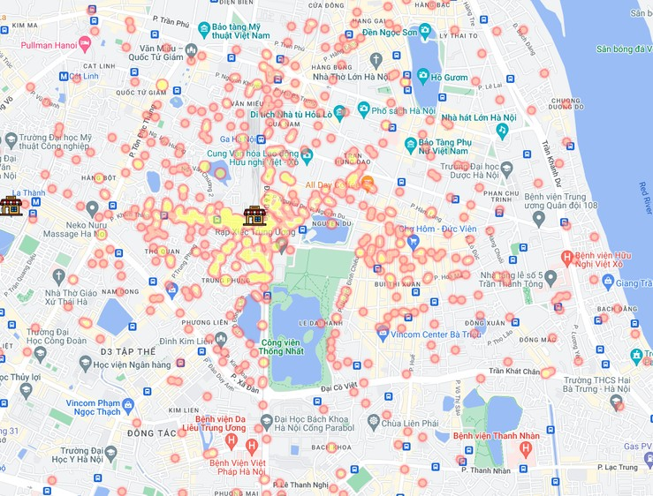
06
CASE STUDY | RETAIL LOCATION HEATMAP
Challenge
A Japanese client requires a map website to exploit business data and analyse the market by geographical location.
Approach
VTI proposed a heatmap solution to capture new customer preferences and behaviour patterns.
Customer information from stores is inspected, aggregated, and analysed to support sales and marketing campaigns.
Result
Better grasp of customer expectations, signiﬁcantly improved sales
The client opens a new store at the optimal location based on the heatmap
Data collection and analysis enabled effective market research
41

Slide 43
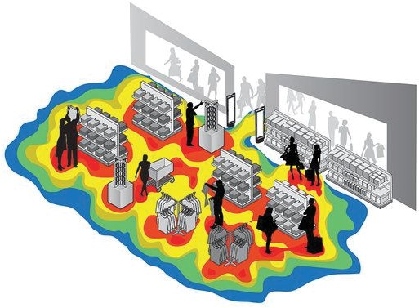
CASE STUDY | IN-STORE LAYOUT OPTIMISATION (HEATMAP)
07
Challenge
Due to the corona wreck, consumers refrained from eating out and shopping ofﬂine, retail sales declined.
=> Client turned to advanced technology and consulted VTI
Approach
Develop an in-store heatmap solution to:
Track customer footprint
Visualise frequently visited/avoided areas as well as customer's attention span
Result
Client optimised in-store layout by strengthening and supplementing
support for busy areas while improving dead zones
42

Slide 44


CONTACT US
Website: vti.com.vn
Email: info@vti.com.vn
Phone: (+84) 24-7303-9996
VIETNAM
• VTI Building, Me Tri Ha Urban Zone, Nam Tu Liem, Ha Noi
• Dakao Center Building, No. 35 Mac Dinh Chi, Tan Dinh Ward, Ho Chi Minh City
KOREA
• 13 Floor, Goryeo Daeyeongak Tower, 97 Toegye-ro, Jung-gu, Seoul, Korea 04535
JAPAN
• 4F & 5F, Akebonobashi SHK Building, 4-3 Katamachi, Shinjuku-ku, Tokyo 160-0001, Japan
• 608, Sanko Building Semba, 1-3-9 Minamihonmachi, Chuo-ku, Osaka-shi, Osaka 541-0054, Japan
• 7F West Side, Nagoya SI Building, 1-7-32 Nishiki, Naka-ku, Nagoya, Aichi 460-0003, Japan
• 601, Hakata Kowa Building, 3-23-12 Hakata Ekimae, Hakata-ku, Fukuoka 812-0011, Japan
SINGAPORE
• Gateway East – 36th Floor, 152 Beach Road, Singapore 189721

